Slide 1



DOCKER & CONTAINERS
Day 5 : Practical Containerization
Omar Tokal
DevOps Engineer at DropMe

Slide 2




THE APP DEPLOYMENT PAIN
Works on Local Machine
Crashes in Production
The software developer builds an amazing app. It runs perfectly on their local computer with Node.js v21, custom packages, and specific environment variables.
The Operations engineer deploys it on the production server. But the server has Node.js v18 and missing system libraries. The application crashes immediately.
The Painful Results
Different software settings cause environment drift.
Hours wasted trying to debug dependency version conflicts.
Arguments between developers and systems operators.

Slide 3

CARGO SHIPPING INSPIRATION
Standard Cargo Containers
Before the 1950s, shipping cargo was messy. Workers had to load different sizes of boxes, bags, and items onto ships manually.
The shipping industry solved this by creating standard steel containers. Any cargo fits inside the same standard box, which easily loads onto any ship, train, or truck.

Slide 4
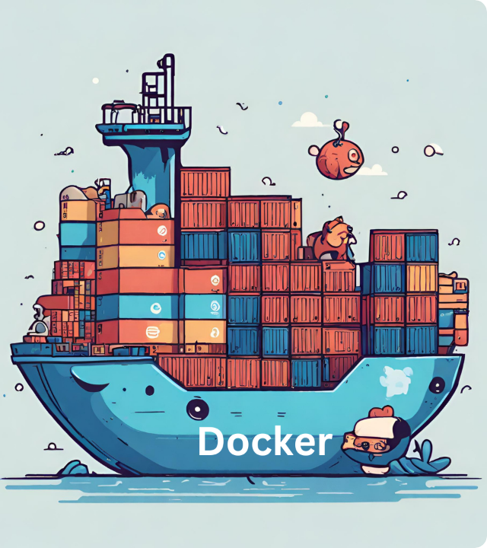
SOFTWARE CONTAINERS
Package Once, Run Anywhere
Docker brought the cargo shipping concept into software engineering.
Instead of shipping raw code, we pack our code, runtime settings, system tools, and databases into a single, standardized Software Container that runs on any server instantly.

Slide 5


MONOLITHIC VS. MICROSERVICES
Monolithic Architecture
Microservices Architecture
Entire app is built and deployed as a single, giant unit.
Application is split into multiple independent services.
If one tiny part fails, the entire application goes down.
If one service crashes, other features stay running.
Scaling specific parts of the app is very expensive.
Easy to scale individual components separately.

Slide 6

THE PAIN OF MICROSERVICES
More Services = More Problems
While microservices are highly scalable, managing them without containerization leads to operational challenges:
Resource Waste: Running a Virtual Machine for every service consumes massive RAM and CPU.
High Infrastructure Costs
Dependency Conflicts: Service A needs Python v3.10 while Service B requires Python v3.8.
Traditional virtualization forces you to buy separate OS licenses and allocate heavy hardware profiles for simple backend APIs.
Deployment Complexity: Managing 50+ isolated servers and different libraries gets confusing.

Slide 7


WHAT IS DOCKER?
Lightweight Application Isolation
Docker is an open-source tool designed to package and run software inside lightweight, isolated containers.
Independent: Containers hold their own files, libraries, and configurations.
The DevOps Game Changer
No Conflicts: Multiple apps run on one machine without database or library conflicts.
Docker ensures your environment remains completely identical from local development to staging and live production systems.
Shared Kernel: Unlike VMs, containers share the host operating system kernel directly, saving resources.

Slide 8
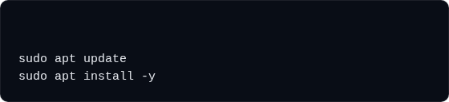
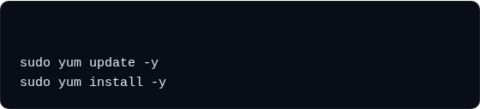
INSTALLING DOCKER
Easy Installation Commands
G
Installing Docker on cloud virtual machines or local Linux distributions takes only a few simple terminal commands.
docker.io
Docker is officially supported on major Linux OS types.
Always update your system packages before running setup.
# Install Docker on Amazon Linux / CentOS
Once installed, the Docker service runs as a background system daemon.
docker

Slide 9
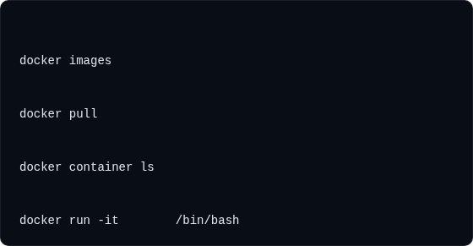
BASIC DOCKER COMMANDS - PART 1
Managing Images & Running States
# List all downloaded images
These commands are the fundamental toolbox for working with Docker containers and inspecting templates.
# Download an image from Docker Hub
Pulling: Downloads image templates from Docker Hub.
ubuntu
Listing: Shows the images or containers active on the server.
# List running containers
Running: Boots a new isolated filesystem from your chosen template.
# Start an interactive container
ubuntu

Slide 10
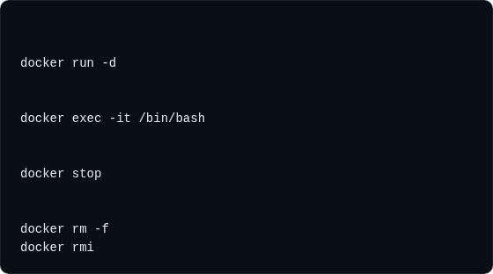
BASIC DOCKER COMMANDS - PART 2
Stopping, Executing, & Deleting
# Run Nginx in background
To operate a containerized stack smoothly, you must know how to stop containers and enter their isolated environments.
nginx
# Execute shell inside active container
Detached Mode (-d): Runs containers in the background so your shell remains free.
# Stop a running container
Execution (exec): SSH directly into a running container to troubleshoot.
# Force remove container and images
Force Removal (rm -f): Stops and deletes a container instantly.

Slide 11
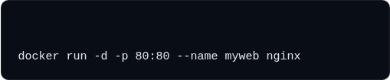

CONTAINER PORT MAPPING
Bridging Host and Containers
By default, containers run inside private networks and cannot be reached from the public internet.
# Map host port 80 to container web port 80
Port mapping exposes container service ports through the host operating system ports.
Public Traffic Flow
Syntax: -p hostPort:containerPort
Client Browser → Host IP:80 → Docker Port Binding Engine → Private Container:80 → Running Website.
Background execution: -d keeps terminal open.
Naming containers: --name sets easy aliases.

Slide 12
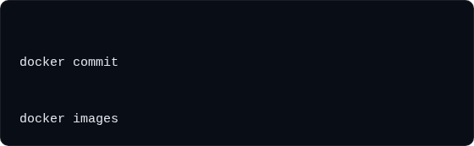
SAVE CONTAINER STATE: COMMIT
Creating Custom Images from Changes
When you modify files or settings inside a running container, those changes are lost if the container is deleted.
The docker commit command lets you snapshot a container's current state into a new reusable image.
# Format: docker commit
myweb
mycustomnginx:v1
Saves active updates, updates, or custom software files.
# Verify the newly created image template
Great for creating sudden backups during live debugging.
Avoids having to rebuild your whole software environment from scratch.

Slide 13
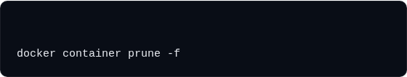
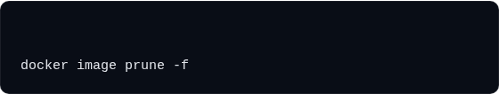
AUTOMATED CLEANUPS
Reclaim Storage and Memory
Leftover stopped containers, unused cache layers, and old image templates can quickly fill up your server's storage.
# Remove all stopped containers
Docker provides safe pruning commands to automatically identify and clean up junk files.
Pruning only removes stopped or unused items.
# Remove all unused dangling images
Saves disk space on CI/CD deployment nodes.
Ensures system performance remains stable over time.

Slide 14
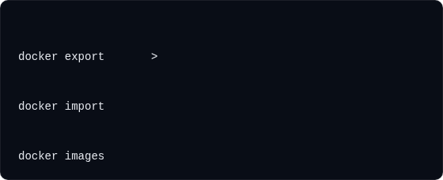
EXPORTING & IMPORTING TARBALLS
Offline Container Migration
Sometimes you need to move a running application to an offline environment without public internet access.
# Save container filesystem into an offline TAR file
myweb
myapp.tar
Exporting packages the container's entire active filesystem into a single distributable TAR archive.
# Load the TAR archive as a new Docker image
myapp.tar
importedweb:v1
Easy to share via USB or offline network drives.
# Verify imported image is ready
Saves exact application files and custom databases.
Can be imported onto any destination host running Docker.

Slide 15
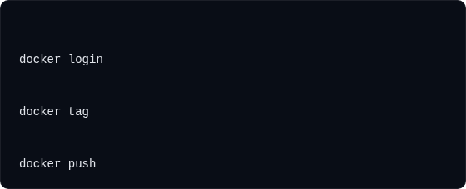
PUBLISHING TO DOCKER HUB
Global Image Distribution
Docker Hub is a public registry that lets you share customized application images with other engineers.
# Log into your secure Docker Hub registry account
Before pushing, you must tag your local image to match your personal registry namespace.
# Tag the image with username and repo name
mycustomnginx:v1
username/repository:v1
Ensures images are secure, tagged, and versioned.
# Push local custom image to Docker Hub
Allows developers to pull custom code instantly anywhere.
username/repository:v1
Integrates with automated cloud pipelines.

Slide 16
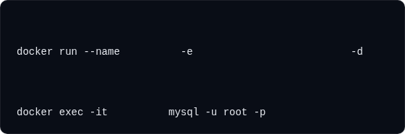
MYSQL DATABASE SANDBOX
Injecting Configuration Variables
Many official enterprise images (like databases) require startup environment variables to run successfully.
# Run MySQL container in background with ROOT password
Running a database inside a container lets you spin up test databases locally in seconds without complex setup.
mysql-db
MYSQL_ROOT_PASSWORD=root
mysql
-e injects required environment secrets.
# Enter running database CLI environment
mysql-db
Prevents local file pollution on host operating systems.
Lets developers test database logic locally with ease.

Slide 17

DOCKER NETWORKING
Why is Dedicated Networking Needed?
As microservice architectures grow, containers must communicate reliably and securely.
Docker Networking provides isolated layers that secure and route traffic between container groups.
Zero Trust Network
Network Isolation: Restricts database containers from receiving direct public internet traffic.
By creating private Docker networks, we secure our database containers. Only the web container is exposed to the internet, while backend systems stay protected.
Name Resolution: Containers resolve and talk to other instances using their container names.
Dynamic Scaling: Dynamically links new application replicas to active routing networks.

Slide 18
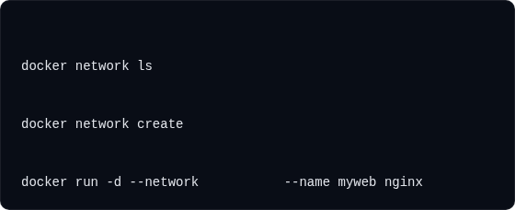
NETWORK DRIVERS & MANAGEMENT
Default Network Types
# List all active Docker networks
bridge: Private internal network (Default).
host: Shares physical network port layer directly.
# Create private bridge network
mynetwork
none: Complete offline isolation (No network adapter).
overlay: Connects multiple hosts running swarm networks.
# Run container attached to your custom network
mynetwork

Slide 19

PERSISTENT DATA & VOLUMES
Why Do We Need Volumes?
Containers are ephemeral. This means any files created inside them are lost forever when the container is deleted.
Volumes map data outside the container, ensuring your files stay safe and persistent.
Persistent State
Prevent Data Loss: Upgrading or deleting a container won't affect database storage.
"Ephemeral containers combined with persistent volume adapters deliver the ideal DevOps balance of modular software life cycles and permanent database records."
Share Common Data: Multiple containers can read/write to the same folder.
Easy Backups: External backup scripts can easily access persistent directories on the host.

Slide 20
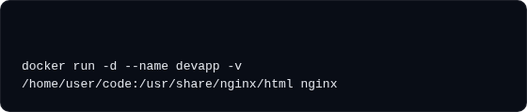
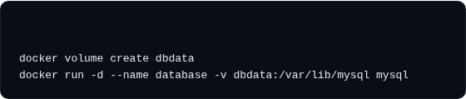
MOUNTING STORAGE IN PRACTICE
Choosing the Right Mount Type
# Bind Mount (Map local host directory to container)
Bind Mounts: Manually link a specific host folder to a container directory. Perfect for developing code live.
Named Volumes: Managed automatically by Docker. Files are stored securely inside /var/lib/docker/volumes.
# Named Volume (Docker managed, recommended for production)

Slide 21

DECLARATIVE IMAGES: THE DOCKERFILE
Infrastructure as Code for Images
Instead of manually tweaking running containers and committing them, we declare image blueprints inside a text file.
Immutable Environments
The Dockerfile automates image building, ensuring your environments are identical and easily reproducible.
Storing your Dockerfile in git source repositories allows you to track and version-control your server configurations alongside your application code.
FROM: Sets the base parent image (e.g., Ubuntu, Alpine).
RUN: Executes command-line scripts during the image build step.
COPY: Transfers files from the host machine into the image.

Slide 22
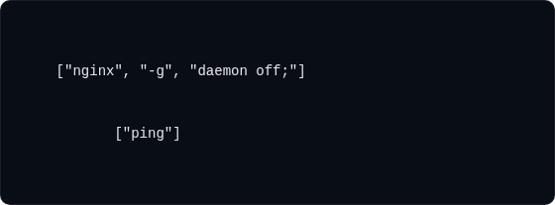
CMD VS. ENTRYPOINT
Defining Startup Behavior
Both instructions define the default command executed when your container spins up, but they handle parameters differently.
# Example 1: Overridden startup arguments
CMD
CMD: Defines default command arguments. Can be easily overridden when running the container.
# Example 2: Strict executable setup
ENTRYPOINT
ENTRYPOINT: Sets a strict default executable. Command parameters passed during startup are appended rather than overriden.
# Running "docker run myimg google.com" appends ping argument

Slide 23
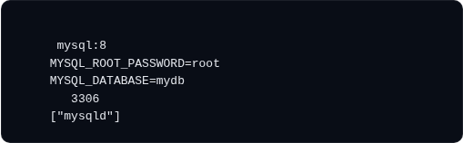
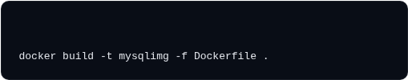
CASE STUDY: MYSQL DOCKERFILE
Automated Custom Database Build
FROM
This Dockerfile builds a pre-configured database image, injects login secrets, and exposes networking ports.
ENV
ENV
EXPOSE
CMD
ENV: Sets system environment variables inside the image.
EXPOSE: Informs Docker that container listens on port 3306.
Building: Compiles instructions into a customized image.
# Build custom database image template

Slide 24
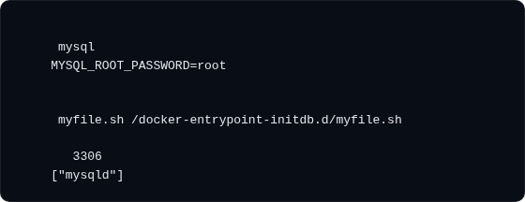
SEEDING INITIAL DATABASES
Pre-Configuring Databases
You can automate database setups by executing initialization scripts during container startup.
FROM
ENV
Copying SQL or shell scripts into /docker-entrypoint-initdb.d/ runs them automatically when the database boots.
# Copy setup script into auto-initialization folder
COPY
Creates required tables and schemas instantly.
EXPOSE
Ensures local developer test databases are ready to use.
CMD
Reduces manual database configuration steps.

Slide 25
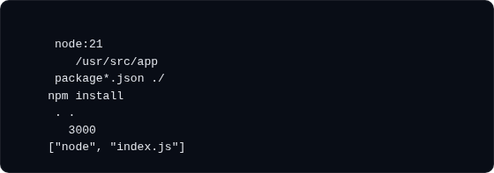
CASE STUDY: NODE.JS DOCKERFILE
Packaging Modern Web Apps
This classic Dockerfile structure is optimized for Node.js microservices and production-grade web deployments.
FROM
WORKDIR
COPY
WORKDIR: Creates and navigates to the default working directory.
RUN
COPY
RUN: Runs npm install to download packages inside the container.
EXPOSE
CMD
COPY: Copies local code files into your container filesystem.

Slide 26
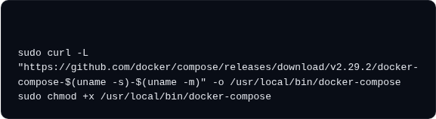

DOCKER COMPOSE
Why use Docker Compose?
Managing multi-container applications (like Web, App, and Database stacks) with standard docker run commands is difficult and error-prone.
# Install Docker Compose utility
Docker Compose lets you define and launch your entire multi-container architecture from a single YAML file.
Single Command: Spin up your entire stack with docker-compose up -d.
Unified Management: Destroys all containers simultaneously using down.
# Spin up multi-container system
Standardized: Saves port mapping and storage volume configurations.

Slide 27
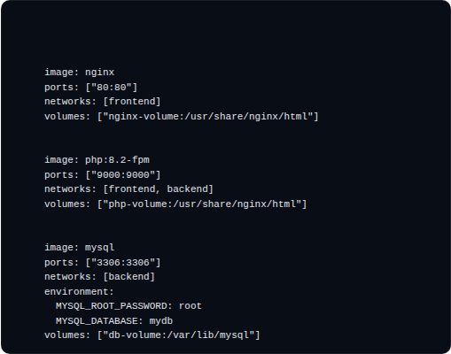
PRODUCTION 3-TIER ARCHITECTURE
services:
Defining Networks, Volumes, and Replicas
web:
This docker-compose.yml file orchestrates Nginx, PHP-FPM, and MySQL database engines securely inside isolated environments.
myapp:
Networks: Separates public frontend traffic from private backend data networks.
Volumes: Mounts host directories to protect database state.
db:
Building from Source: Can build custom images from local directories on the fly.
networks:
volumes:

Slide 28

Questions & Answers
You have successfully completed Day 1 - Session 2: Docker Mastery!
Up Next: Session
Kubernetes
omar.tokal2020@gmailcom | https://www.linkedin.com/in/tokal/

